Slide 1
Text Mining with Python
Sridhar Palle, Ph.D.

Slide 2
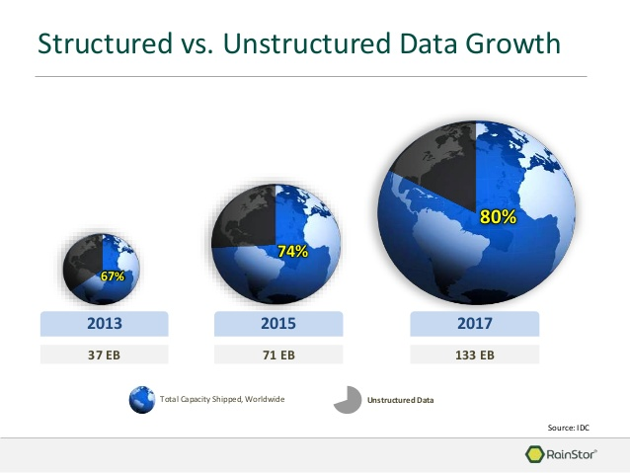
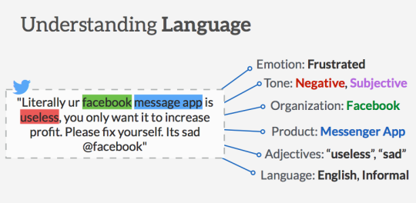
Why Text Mining?
Majority of worlds data is in unstructured form (most of which is text) (Merrill Lynch and Gartner study)
Unstructured corporate data is doubling in
size every 18 months. Ex: 500 million tweets/day
If all the data in the world was equivalent to water on earth, then textual data is like the ocean, making up a majority of the volume (Siegel 2013)
So what exactly is text mining
A process of analyzing vast collections of textual documents to extract key concepts, themes, hidden trends, and make predictions
Better fits the “mining” metaphor in data mining. Separate valuable key words from a mass of other words.
Generating actionable intelligence from textual data is of paramount importance for a variety of industries and applications (Ex: Facebook)
Source: blog.aliyen.com
Notes:
A vast majority of business data are stored in text documents that are virtually unstructured. According to a study by Merrill Lynch and Gartner, 85 to 90 percent of all corporate data are captured and stored in some sort of unstructured form (McKnight, 2005).The same study also stated that this unstructured data are doubling in size every
18 months. Because knowledge is power in today’s business world, and knowledge is derived from data and information, businesses that effectively and efficiently tap into their
text data sources will have the necessary knowledge to make better decisions, leading to a competitive advantage over those businesses that lag behind.

Slide 3
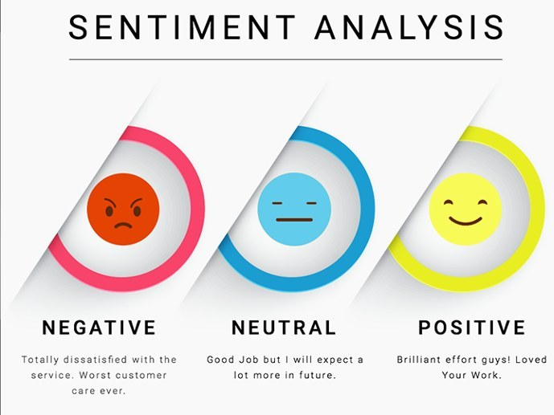
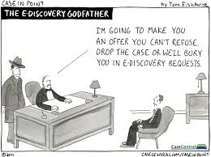
Text Mining Applications
Sentiment Analysis
Ex: analyzing tweets for brand sentiment
Spam filtering, event detection in emails
Ediscovery problem in Litigation
Marketing applications
Enables better CRM
Security applications
Deception detection
Medicine and biology
Analyzing clinical reports
Academic applications
Journal reviews
Research stream analysis
Source: kdnuggets

Slide 4
Text Mining Process
1. Collect Data
Raw Unstructured data from websites, emails, tweets, journals
2. Preprocess Data
3. Analyze Data
Convert to a structured format
Apply standard descriptive or predictive analytics techniques such as clustering, classification etc.

Slide 5
Text Mining Process
Step 1: Collect Data
Index | Document (tweet, email, article, webpage etc)
1 | I promise that I didn't just sign up to Amazon Prime Video just so I didn't have to get out of bed to put on a different DVD I would never do such a thing
2 | Watch out, online retailers. This is just how big Amazon is becoming:
3 | Amazon Prime Day will last 36 hours this year. As if they haven’t already disrupted enough industries they are now going after time.
4 | ……
5 | …….
6 | I’m a hypocrite who uses @amazon but reading about exploiting people beyond their breaking point & destroying local economies so @JeffBezos can become wealthiest person on planet has me re-thinking it

Slide 6
Text Mining Process
Step 2 : Preprocess – clean & convert to structured format
Step 3 : Applying Supervised or Unsupervised models
Ex: Bag of Words Method (baseline NLP method): One feature for each word
Clean up and break down text into structured format
1. Tokenize: Break down each document or tweet into words
2. Transform Cases: convert to lower or capital case
3. Remove stop words: ‘a’, ‘or’, ‘is’, ‘are’
4. Remove Punctuation: @, . “, /
5. Stemming
6. n-grams
Twt | Amazon | big | never | hypocrite | sign | ..
Tw.1 | 1 | 1 | 0 | 0 | 1 | 1
Tw.2 | 2 | 1 | 0 | 1 | 0 | 2
Tw.3 | 1 | 0 | 1 | 0 | 0 | 1
Tw.4 | 1 | 2 | 0 | 1 | 0 | 0
Tw.5 | 1 | 0 | 1 | 2 | 1 | 1
Tw.6 | 3 | 1 | 0 | 0 | 1 | 0

Slide 7

Techniques for Sentiment Analysis
Unsupervised Knowledge-based models
Leverages Lexicons/databases
Supervised Models
Statistical models & Machine Learning
Hybrid Approaches
Combines the elements of both Supervised and Unsupervised ML models

Slide 8
Unsupervised Lexicon based Models
Unsupervised models are based on well curated
knowledgebases, lexicons, ontologies, and databases
These lexicons have detailed information (sentiment, mood, polarity, subjectivity etc..) related to subjective words and phrases
Sentiment on a particular text document can be computed by matching the presence of words in the document with the knowledge-bases and lexicons
Lexicons are typically vocabularies of words specially constructed to compute sentiment without the need for any supervised techniques

Slide 9
Popular Lexicons/Databases for Sentiment Analysis
Several popular Lexicons:
AFINN Lexicon
SentiWordNet Lexicon
Vader Lexicon
Pattern Lexicon
Bing Liu Lexicon
MPQA Subjectivity Lexicon
Wordstat
SenticNet

Slide 10
Few Lexicons for Sentiment Analysis (With Python packages)
Afinn Lexicon
Simplest and popular lexicon
3300+ words with polarity scores
Developed and curated by Arup Nielsen
Wrapper library in Python
SentiWordNet Lexicon
Popular lexicon based on WordNet synsets
NLTK library provides Python interface into SentiWordNet
Vader Lexicon
Rule based sentiment analysis specifically tuned for social media sentiment analysis
Developed by Hutto and Eric Gilbert
NLTK library provides Python interface
Pattern Lexicon
Complete package for NLP, text analytics, and information retrieval
Developed by CLiPS (Computational Linguistics & Psycholinguisitics) research center
Modules for analyzing sentiment, mood, and modality
Pattern package available in Python

Slide 11
Traditional Supervised Models
Scrape, collect, retrieve textual data
Text Preprocessing
Convert to lowercase,
Remove html tags, Expand contractions
Remove punctuation, and stopwords
Stem or lemmatize
Feature Extraction
Bag of Words
Tf-IDF
Apply Machine Learning models
Train the model
Predict and evaluate models

Slide 12
Text Mining with Python
Please go to the link below
Tinyurl.com/ece-appliedml/
Download the folder
TM-Sentiment
Open Jupyter notebooks related to text mining using Anaconda

